Slide 1
Superintendent’s Update
November 3, 2022
December 2018

Slide 2
Presentation Objectives
Academically High-Performing District
Schools of the Month
National Principals Month
December 2018

Slide 3
School District Rating
December 2018

Slide 4
Florida Department of Education has named Clay County District Schools an
Academically High-Performing School District
• 2021-2022 school and district grades
• 2021-2022 class size compliance
• 2020-2021 financial audit reviews
Discovering Endless Possibilities
Notes:
14

Slide 5
Schools of Excellence
Schools whose percentage of possible points earned in its school grade calculation is in the 80th percentile or higher for schools comprised of the same grade groupings (elementary, middle, high and combination) for at least two of the last three school years.
Orange Park Elementary
Keystone Heights Elementary
Lakeside Elementary
Paterson Elementary
Fleming Island Elementary
Thunderbolt Elementary
Discovery Oaks Elementary
Discovering Endless Possibilities

Slide 6
Schools of the Month
December 2018

Slide 7
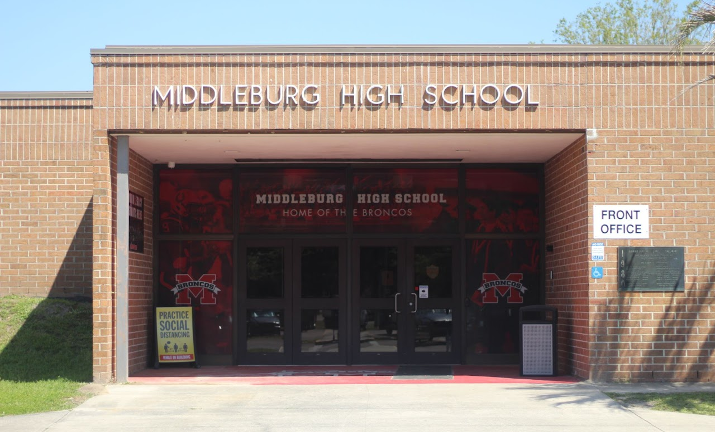
Schools of the Month: October
Theme: School Spirit
Keystone Heights Elementary
Middleburg High
Discovering Endless Possibilities
Notes:
Winning schools will receive: 1. A celebration for all school employees
2. Money towards a school initiative
3. A trophy to display in their school

Slide 8
Who Will Be November’s School of the Month?
Theme: Everyday Heroes
Visit www.oneclay.net to nominate a school
Deadline: Tuesday, November 22
Winners announced at the December board meeting
Discovering Endless Possibilities

Slide 9
National Principals’ Month
December 2018

Slide 10
“Leadership is second only to classroom instruction among all school-related factors that contribute to what students learn at school.”
-National Association of Elementary School Principals, 2013
Discovering Endless Possibilities

Slide 11
Becoming a Principal in Florida
Earn at least a Master's Degree
Hold a certificate in Educational Leadership
Demonstrate success in public school administration (AP)
Successfully complete a Principal Level II Preparation Program
Discovering Endless Possibilities

Slide 12
42 Clay County School Principals
Discovering Endless Possibilities
Notes:
Combined 946 years in education -- average admin has 22 years in education
They taught everything from kindergarten to AP Chemistry, as well as Spanish, Intensive Reading, and IB classes
Combined 472 years in administration -- average admin has 11 years in administration
55 of their own children or grandchildren are attending, attended or graduated from CCDS

Slide 13
Facilitate Family and Community Relationships
Roles of a School Principal
Lead Professional Learning
Plan for the Success of all Students
Oversee Discipline
Oversee Safety and Security
Coach Teachers
Recruit Teachers and Staff
Balance the School Budget
Administer Special Programs
Handle Public Relations
Manage State and Local Assessments
Collect and Manage Data
Supervise Sporting Events
Manage the Facility
Hire Staff
Build Community on Campus
Manage Conflict
Discovering Endless Possibilities
Notes:
Other things they do:
cover classes
clean campus when custodians are out
lunch duty
parent pick up and drop off
filling in on the lunch line when cafeteria personnel are out
maintain the campus (pressure wash, paint walls, landscape)
troubleshoot broken elevators
herding animals (goats) when they get out (Boyack at OHS)

Slide 14
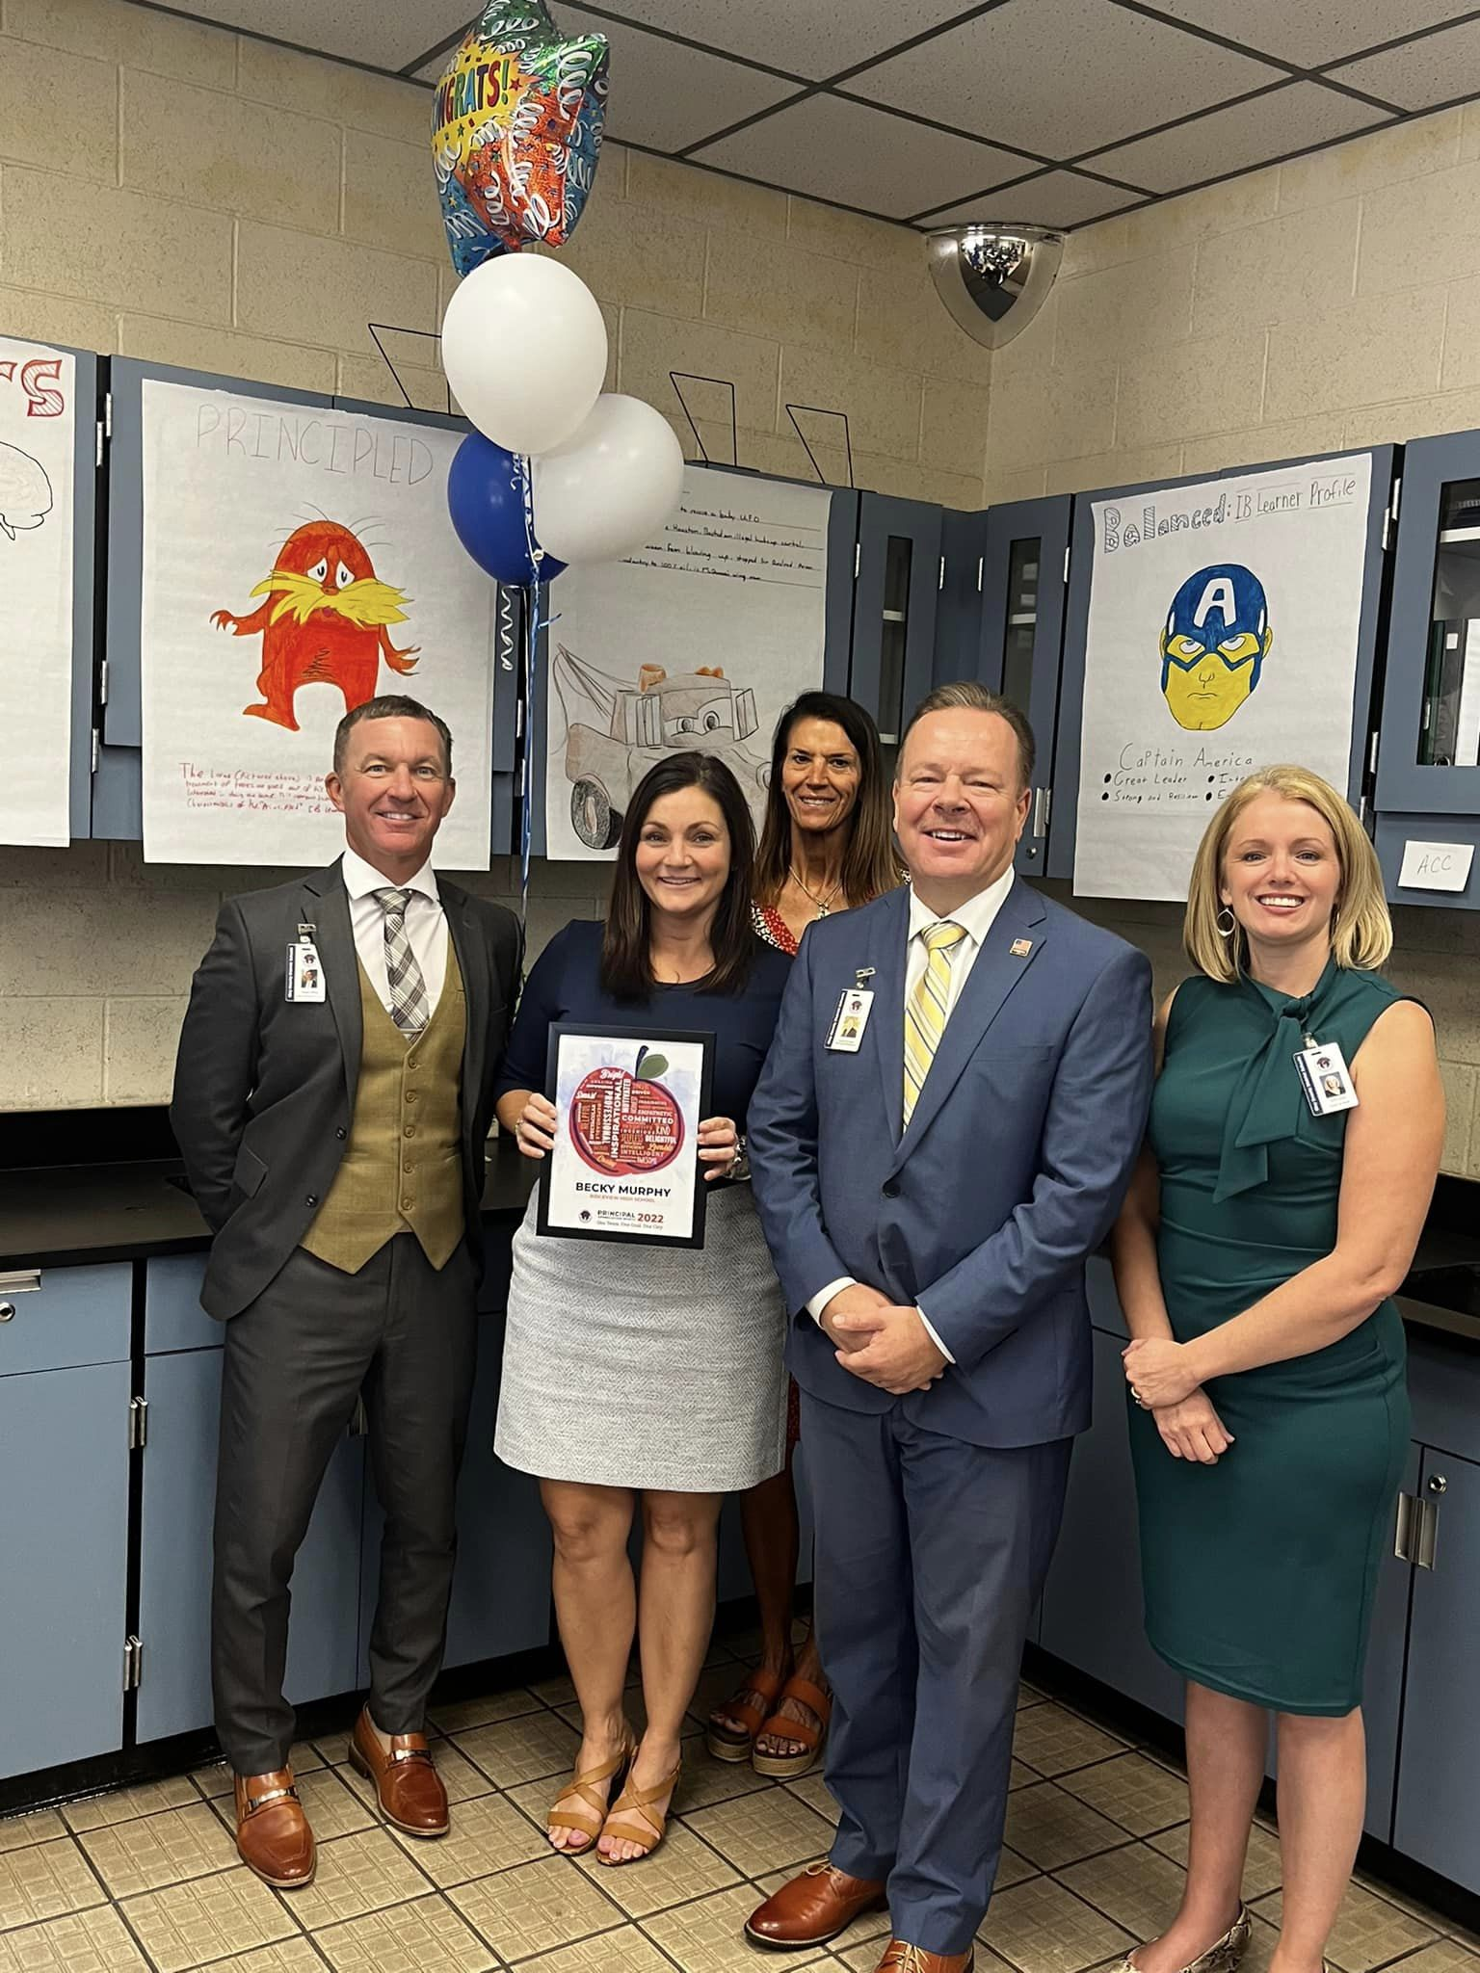
Clay County’s Principal of the Year
Becky Murphy
Ridgeview High
Discovering Endless Possibilities

Slide 15
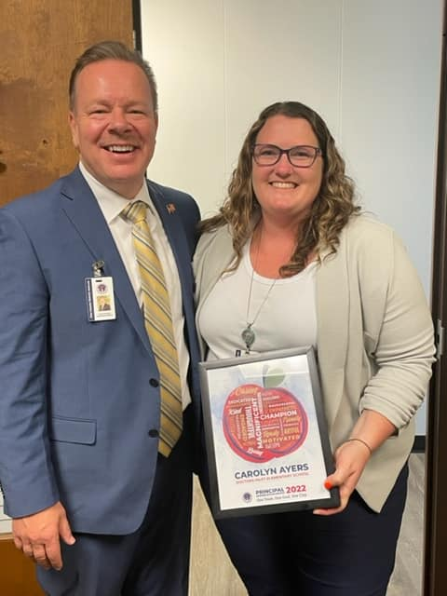
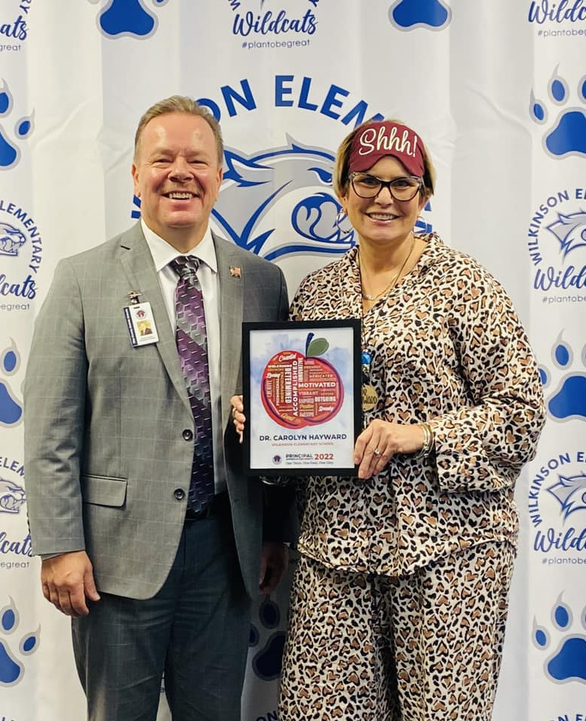
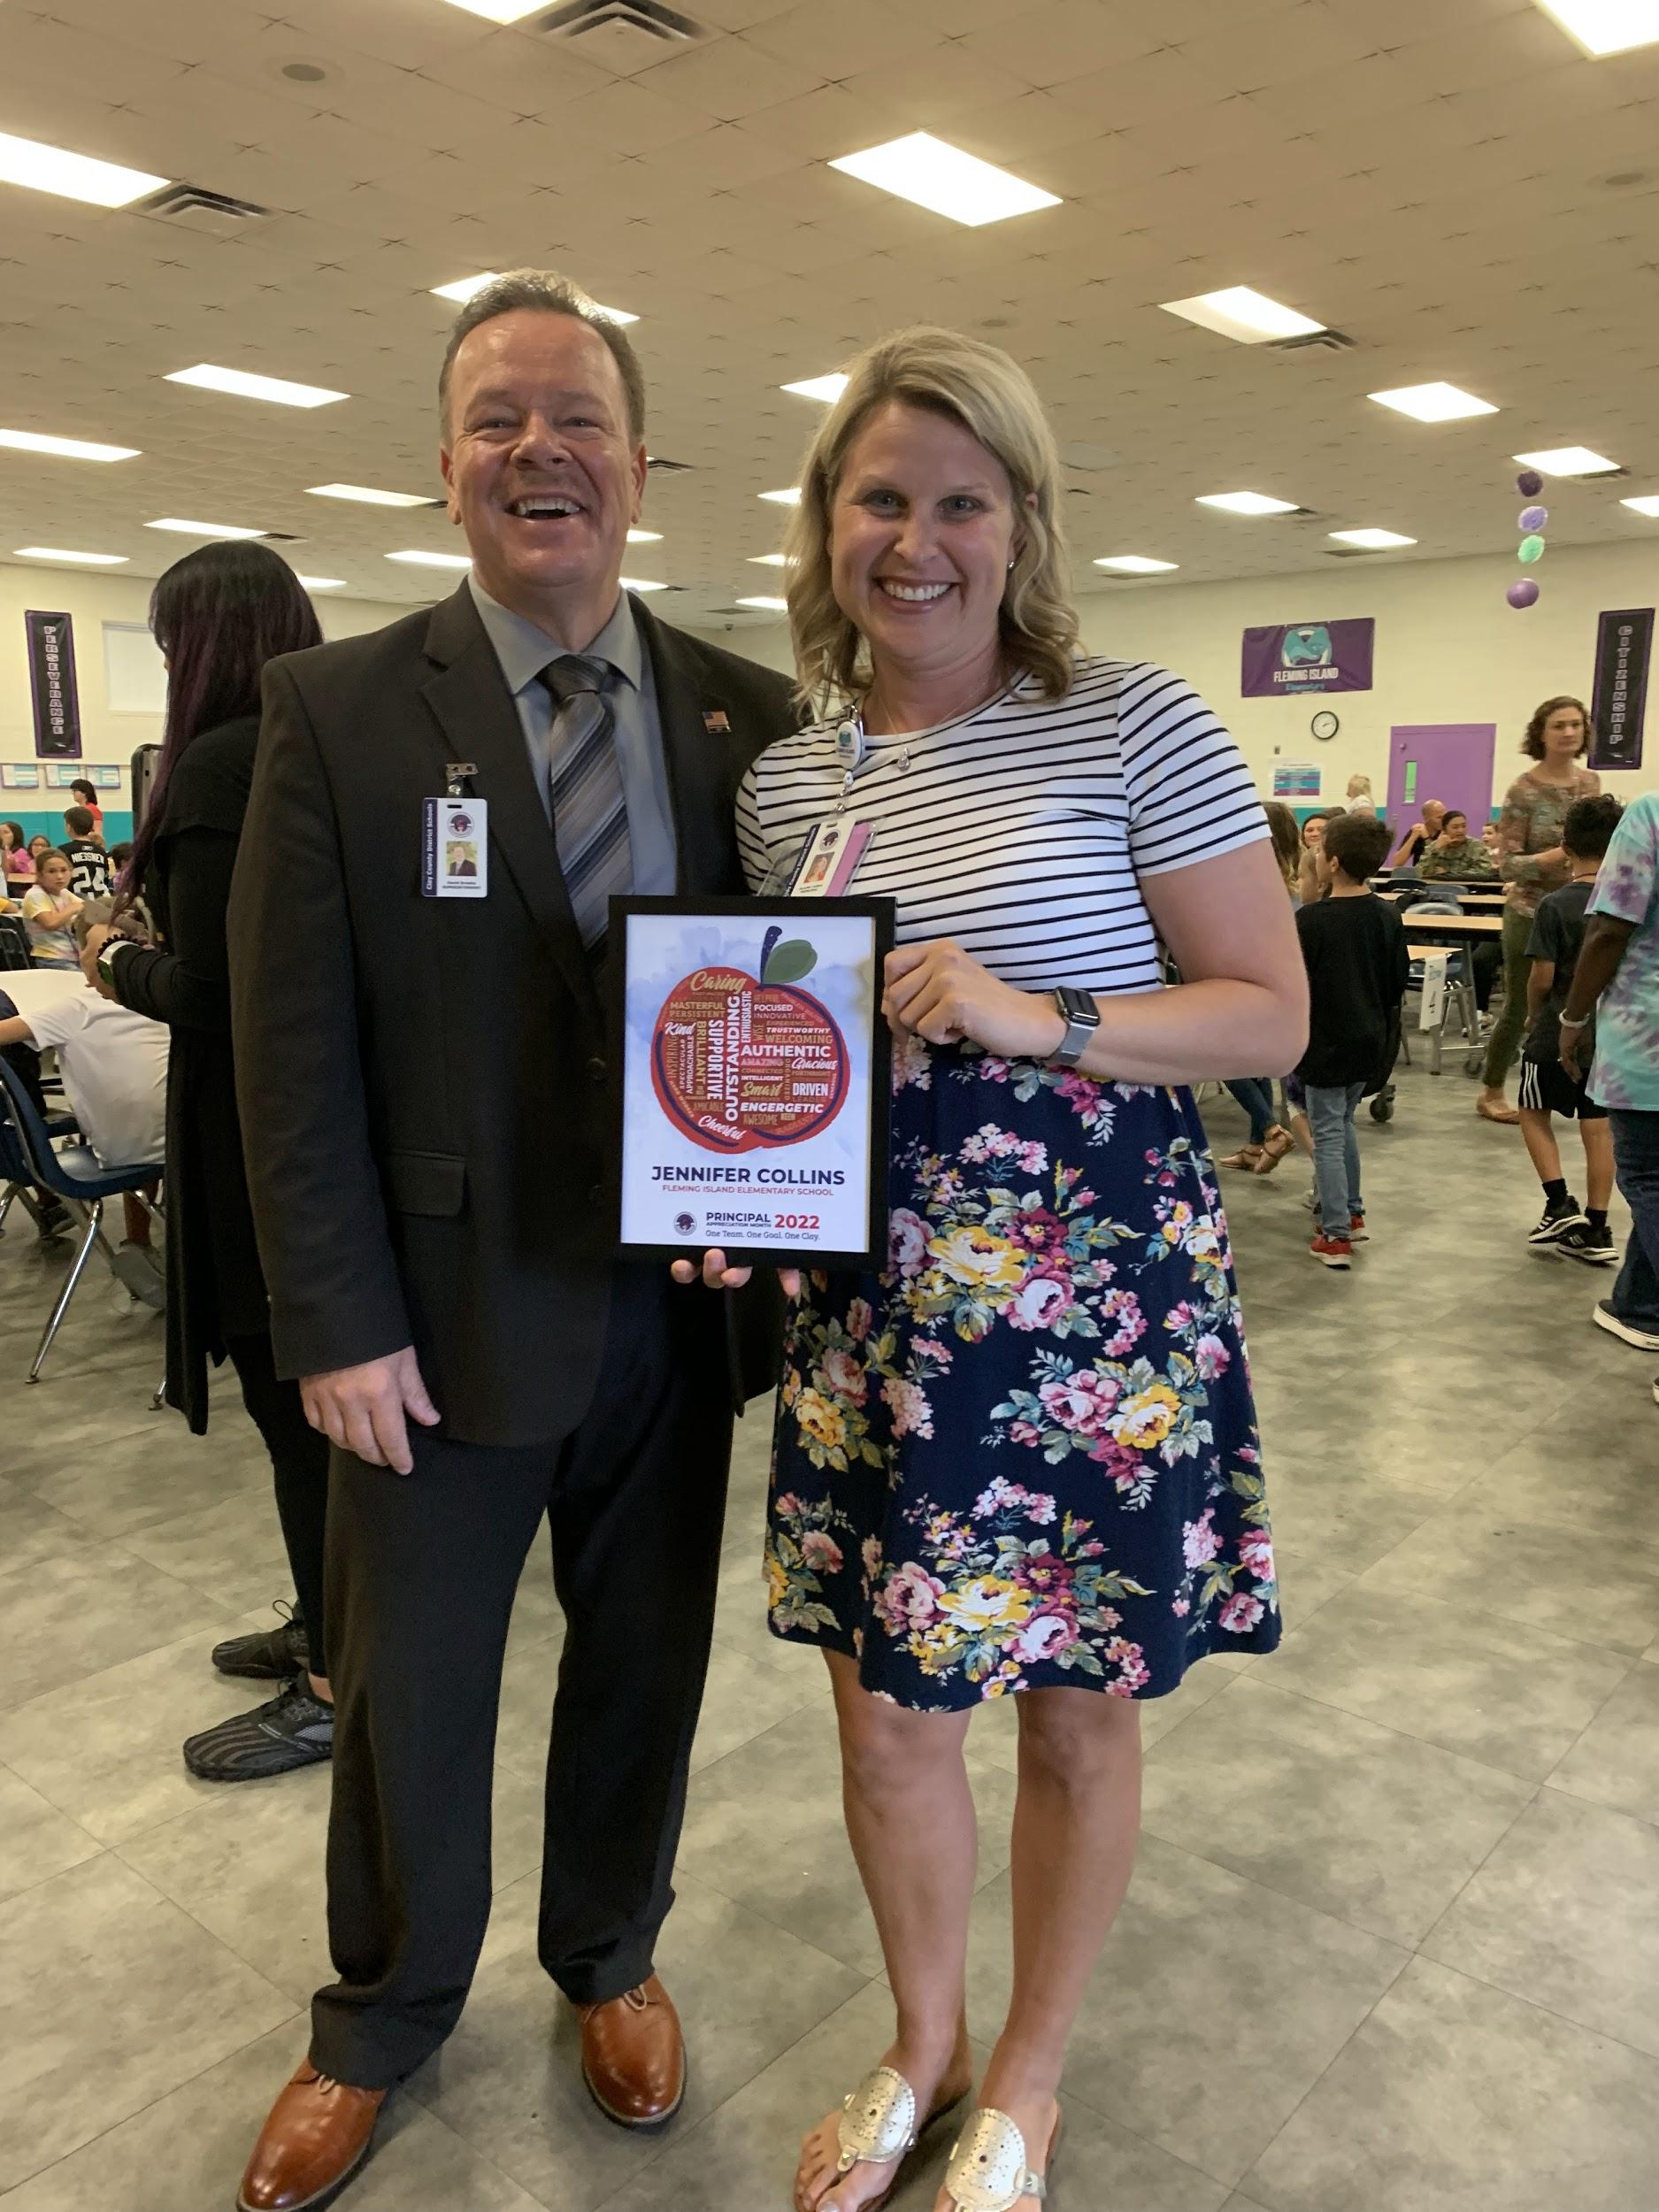
Celebrating Principals’ Month in Clay
Discovering Endless Possibilities
Notes:
Carolyn Ayers, Doctors Inlet
Dr. Carolyn Hayward, Wilkinson Elem
Jennifer Collins, Fleming Island Elem

Slide 16
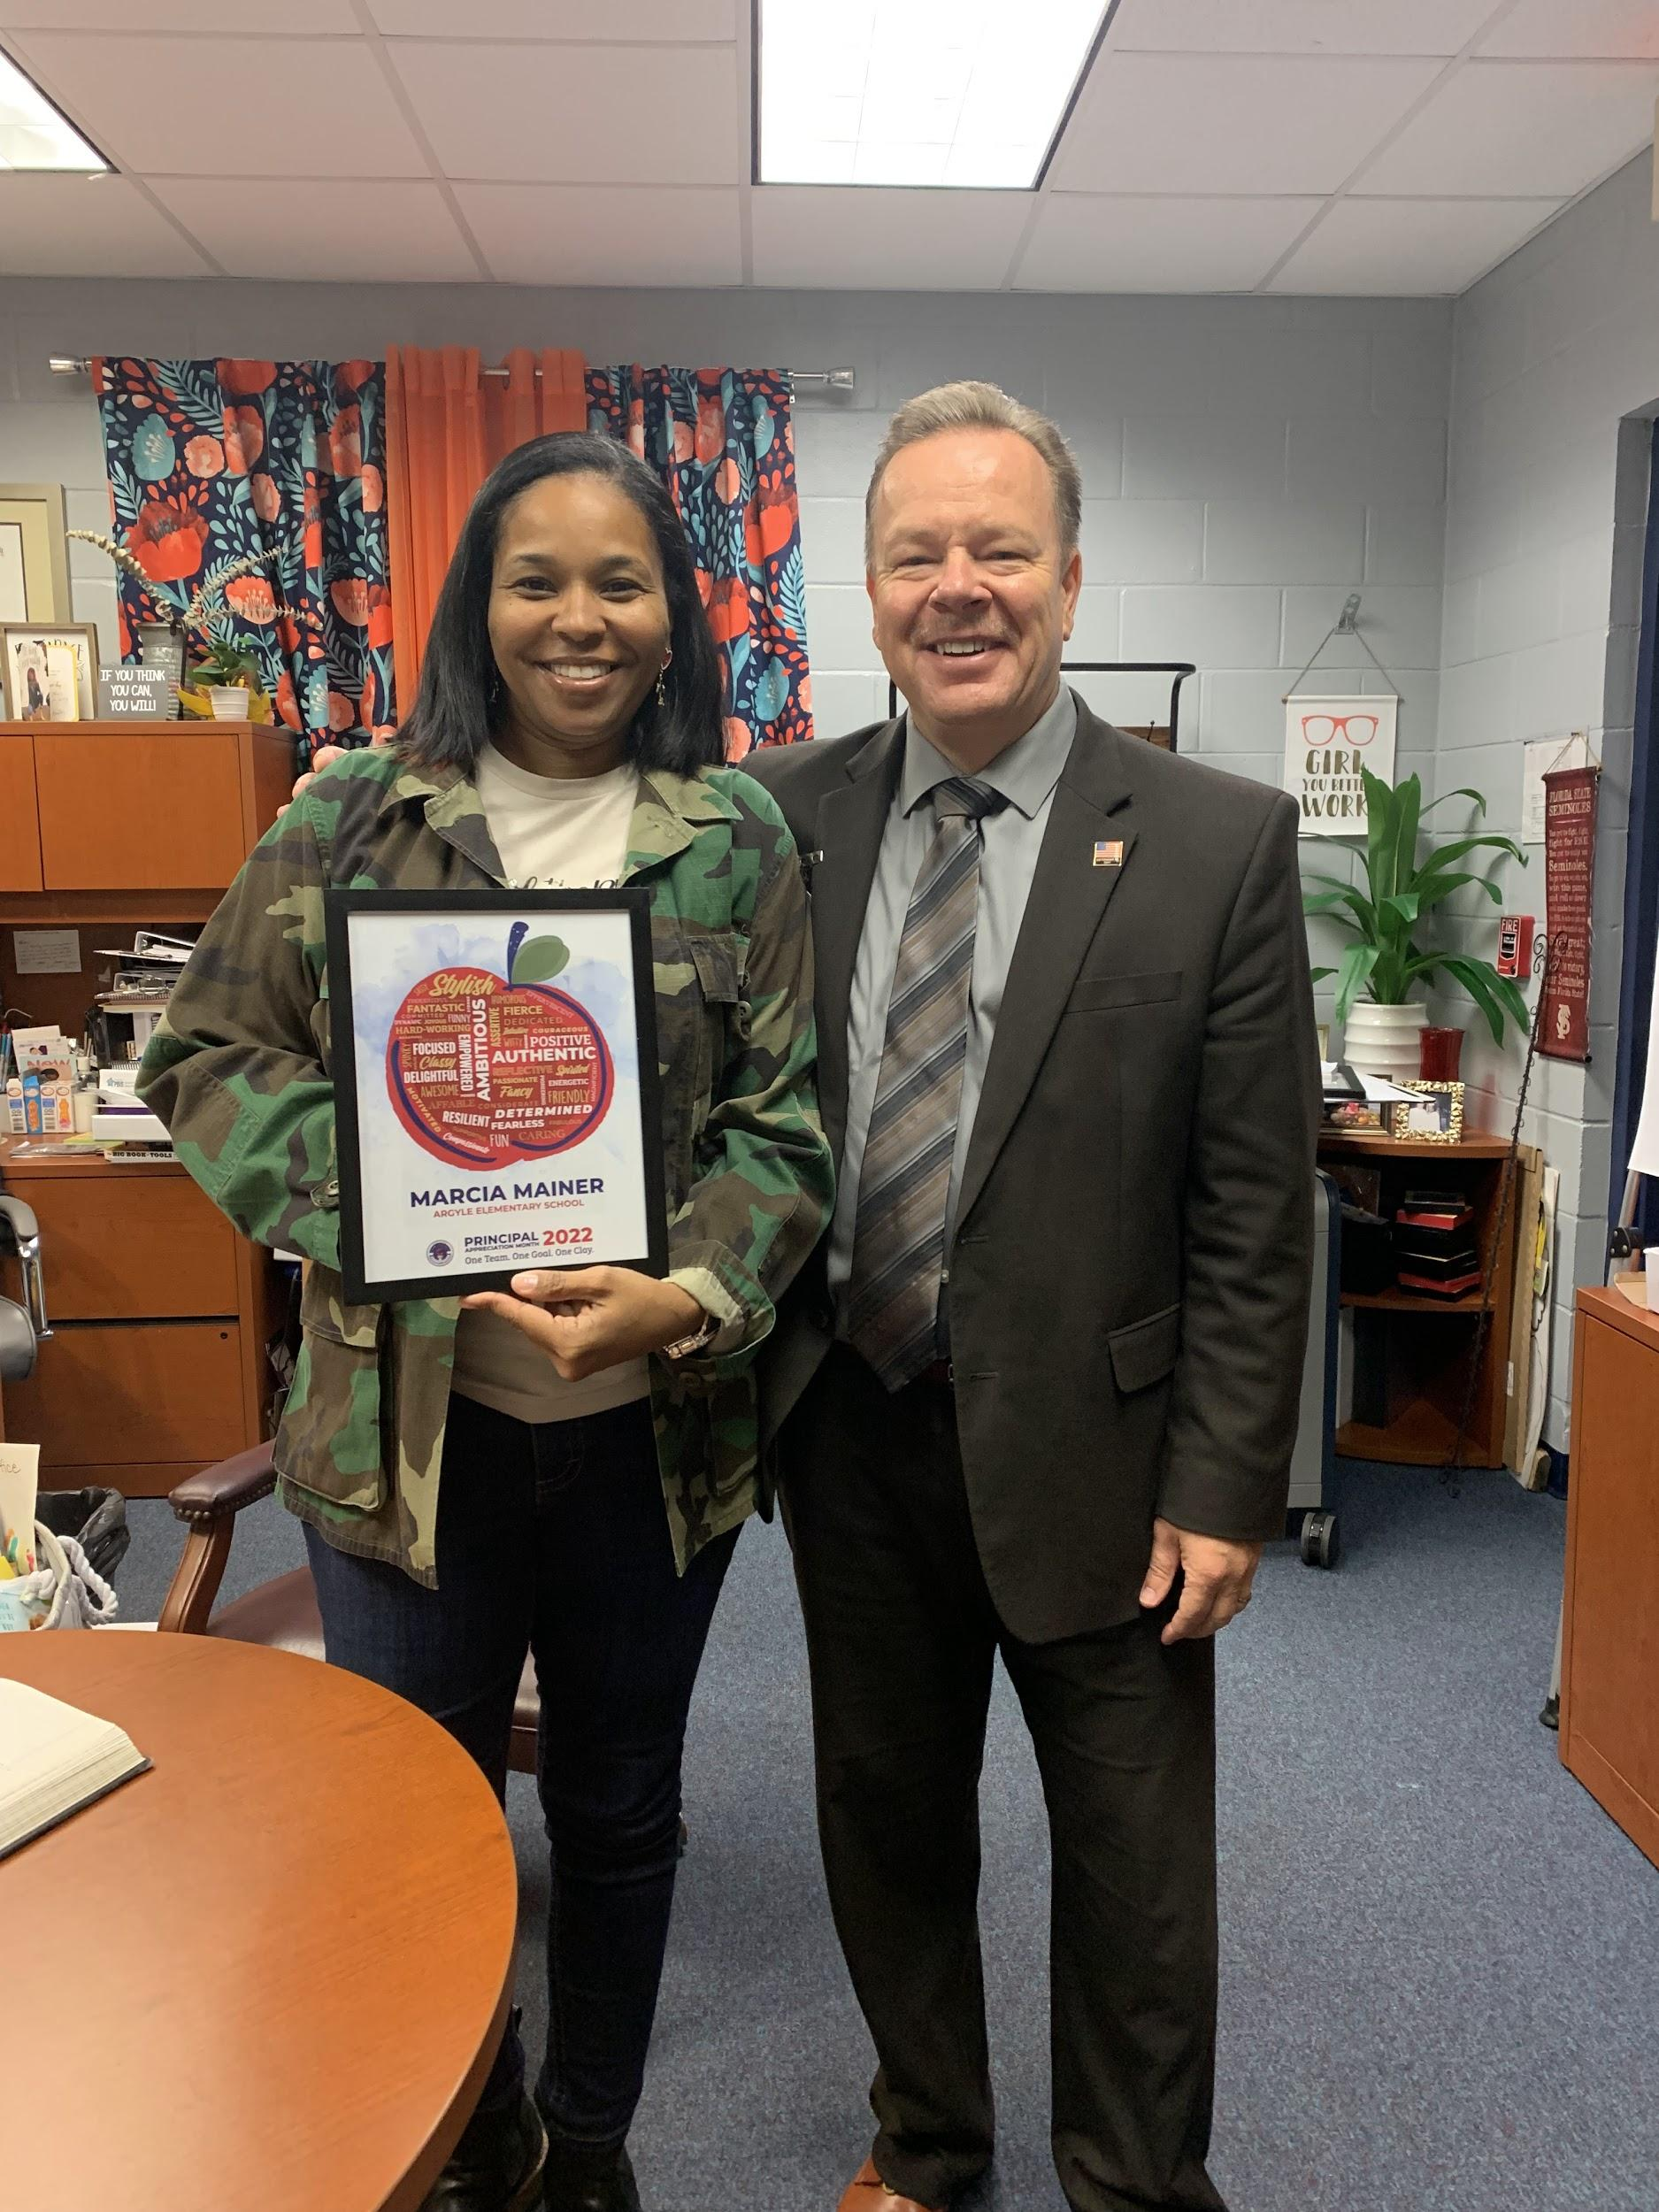
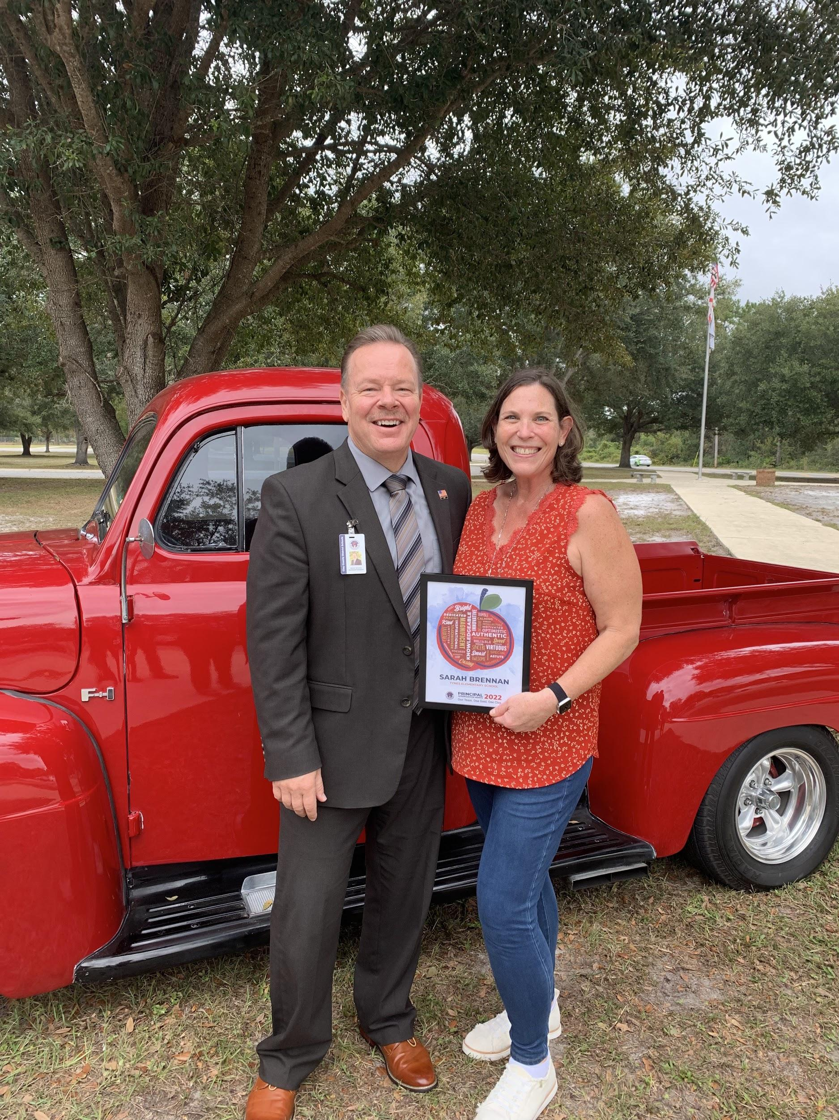
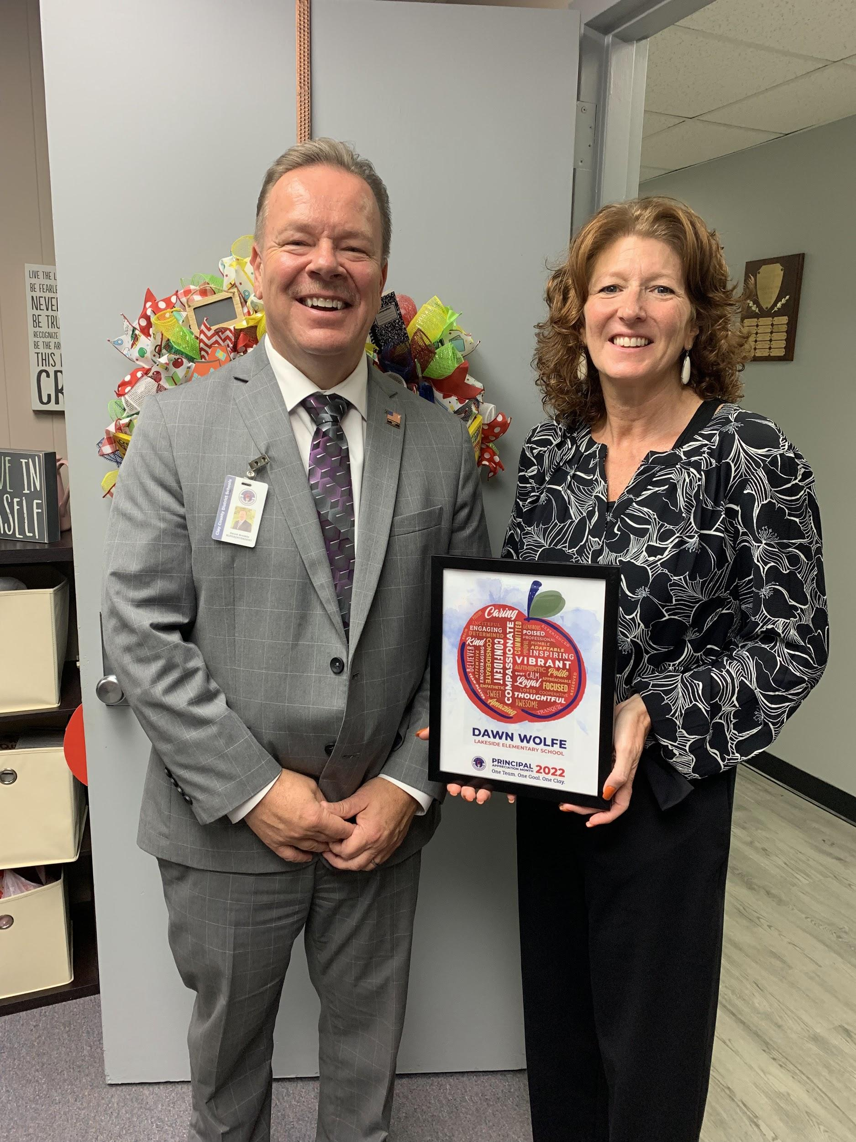
Celebrating Principals’ Month in Clay
Discovering Endless Possibilities
Notes:
Marcia Mainer, Argyle Elem
Sarah Brennan, Tynes ELem
Dawn Wolfe, Lakeside Elem

Slide 17
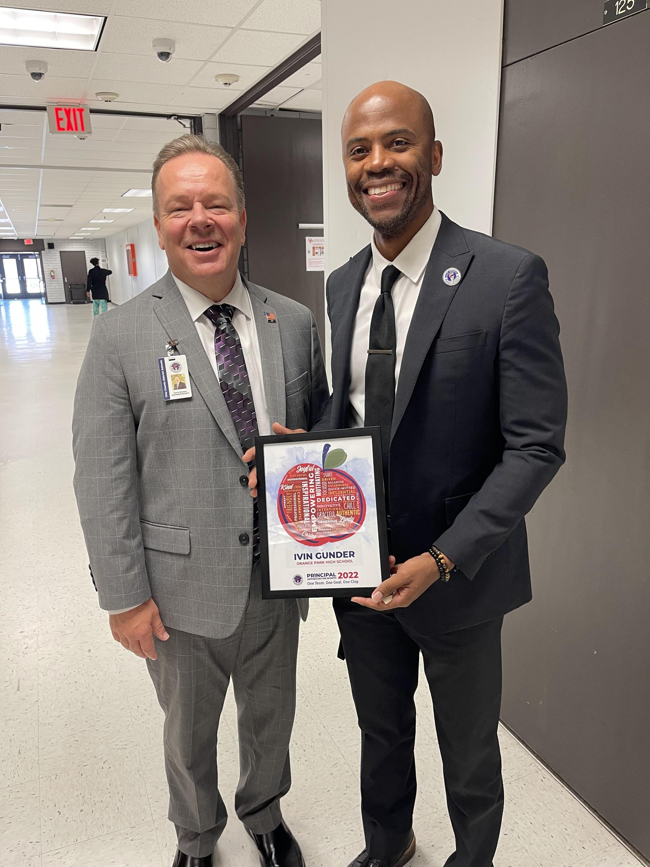
Celebrating Principals’ Month in Clay
Discovering Endless Possibilities
Notes:
Ivin Gunder, Orange Park High
Tania Auguste, Orange Park Junior
Martin Aftuck, Middleburg

Slide 18
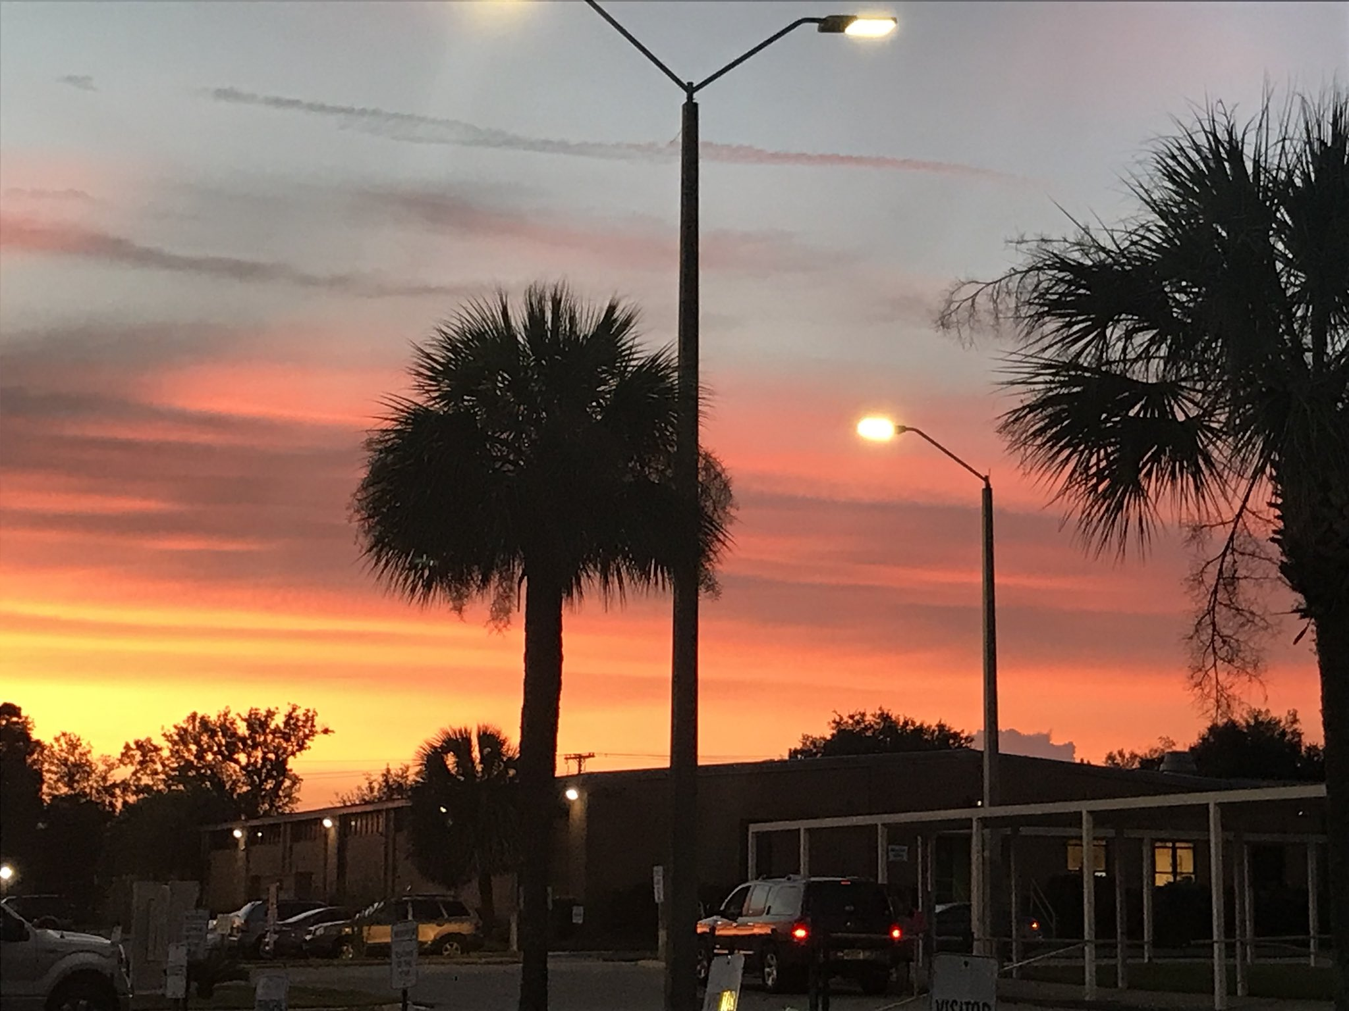
Upcoming Events
Spring Park Elementary School: Rezoning
Impact Fee Study
Five-Year Strategic Plan (2023-2028)
District Accreditation
Discovering Endless Possibilities

Slide 19
Thank you!
Discovering Endless Possibilities

