Slide 1

CLAY COUNTY DISTRICT SCHOOLS
Apptegy Update
July 29, 2025

Slide 2



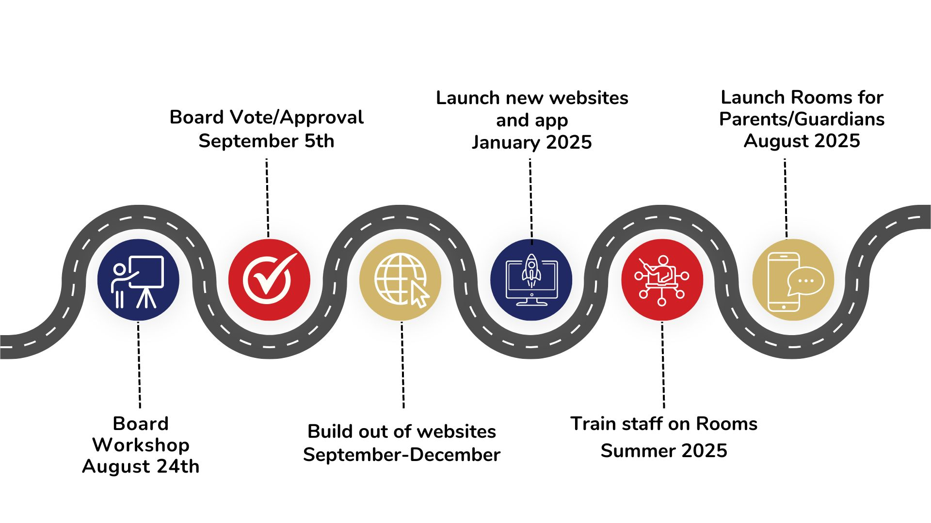
Timeline Review
Here

Slide 3
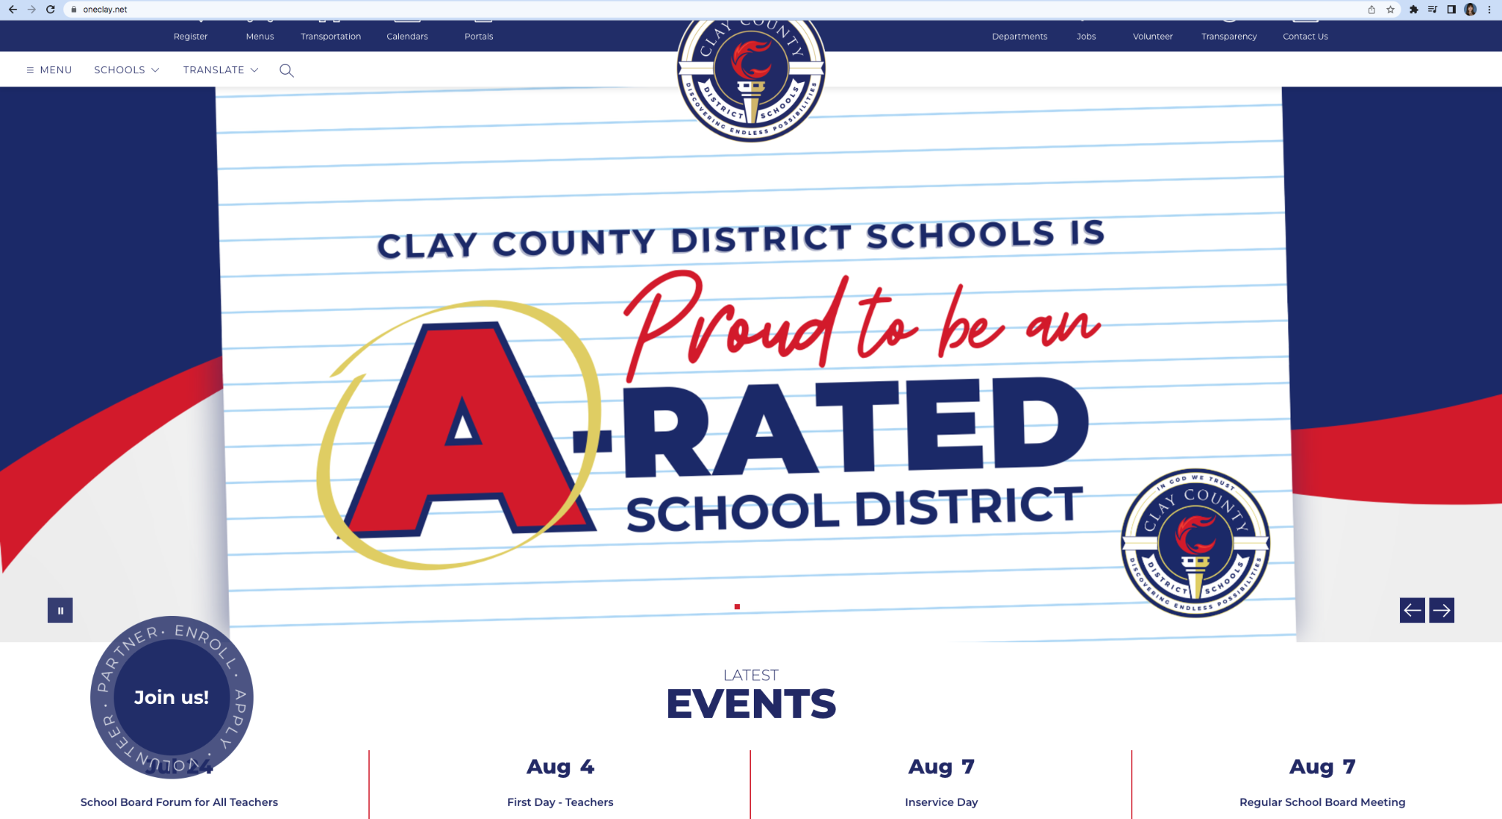
Website Analytics
Key Improvements with the New Apptegy Website (January 1, 2025 - May 20, 2025 vs. January 1, 2024 - May 20, 2024):
Active Users: The new Apptegy website saw a significant increase in active users, growing from 199,000 to 270,000. This represents an increase of 35.68%.
Average Engagement Time: User engagement also dramatically improved. The average engagement time per user on the new Apptegy site is 90 seconds, compared to 40 seconds on the previous site. This is a remarkable increase of 125.00%.

Slide 4
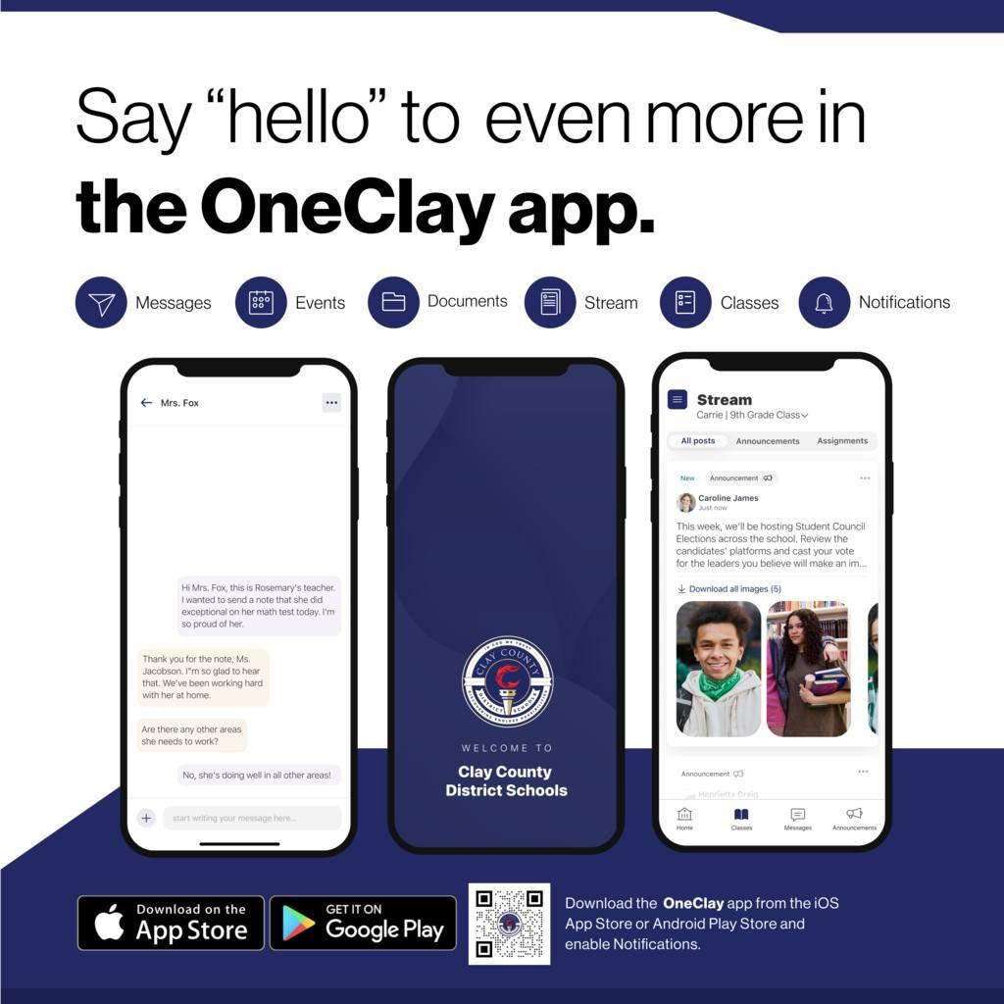
App Downloads
We have continued our drip campaign for downloading the app throughout the summer.
Apple
Total downloads as of May: 9,720
Total downloads as of July 17: 11,000
INCREASE: 1,280
Android:
Total downloads as of May: 4,630
Total downloads as of July 17: 5,200
INCREASE: 570
Total downloads: 16,200

Slide 5
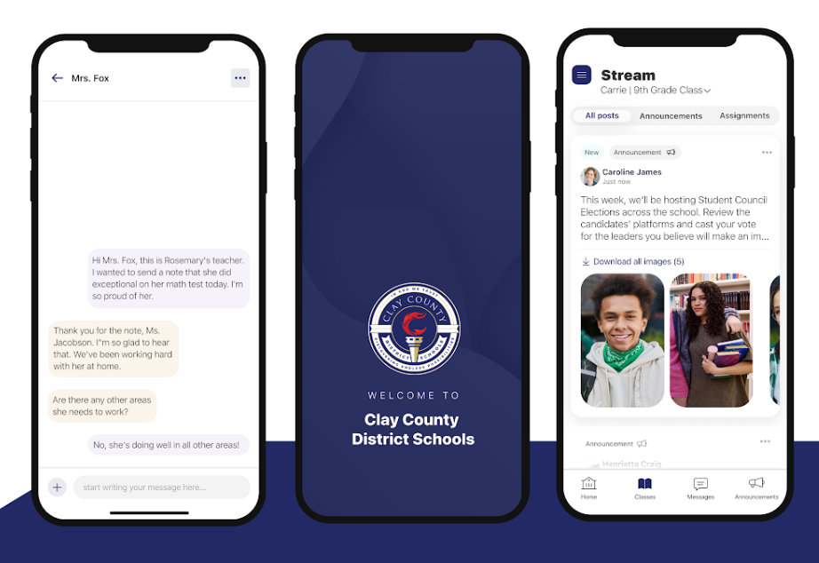
Rooms Update - Launched on May 20
Rooms will be the primary method for school-to-guardian communication for the 2025-2026 school year.
Summer Training Numbers:
  848 teachers trained via in-person IAF sessions in May
  15 Fine Arts Teachers Trained During Fine Arts Summer Academy
  178 Staff members completed Backpack
  201 Staff members have attended summer virtual Rooms training
  17 Athletic Directors have attended Rooms training in July
  28 Administrators trained this summer

Slide 6
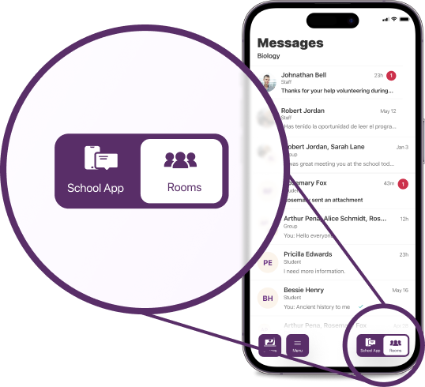
Active Rooms Parent Accounts
We have 36% of our parents/guardians with activated accounts on Rooms
The goal (based on Apptegy) is 50% activation rate
Top Five Schools with Activated Accounts:
  OPE - 53%
  TBE - 49%
  FIE- 47%
  PES - 45%
  LAE - 44%

Slide 7
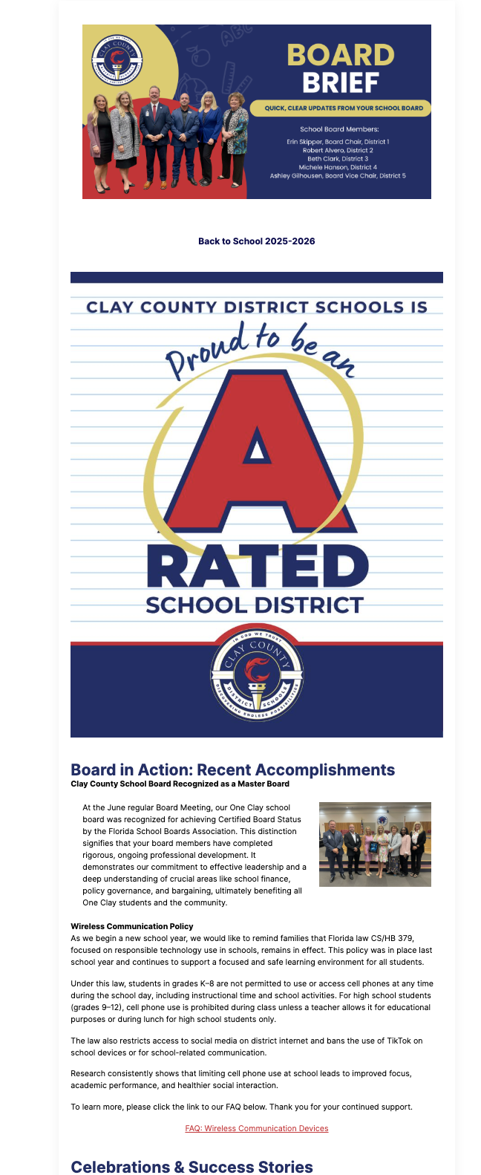
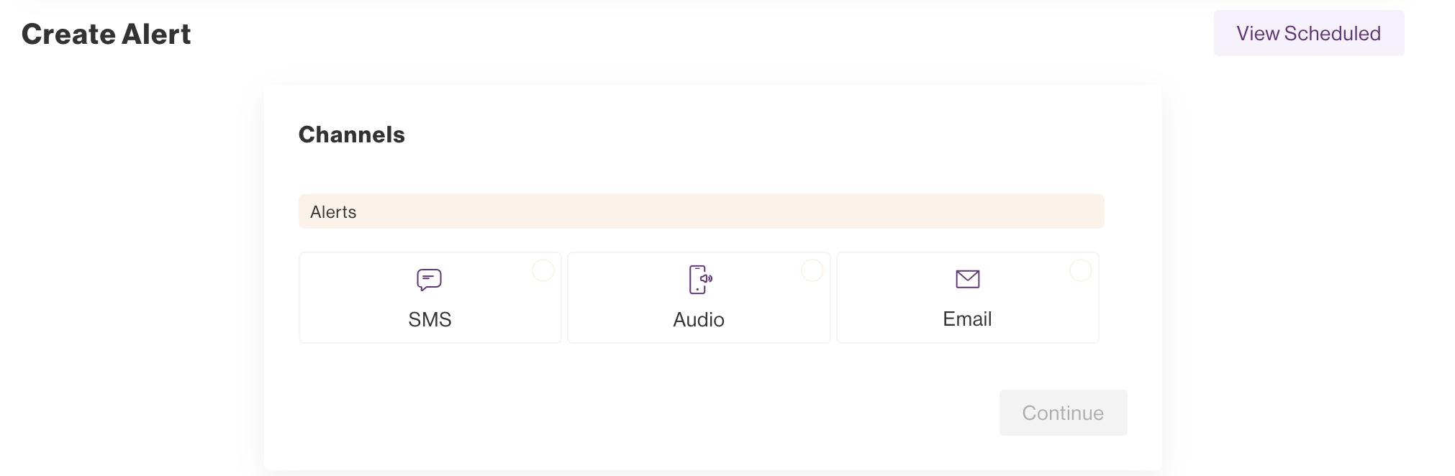
Alerts and Engage
Trained all administrators on Alerts and Engage over summer
Alerts is our Mass Notification system
Engage is our new platform for newsletter

Slide 8
Next Steps & Timeline
Immediate for August:
Continue marketing plan for parents and guardians to download the new app to stay connected with the district and their child’s school.
Continue to train staff on the usage of Rooms.
Continue to refine website pages as needed.
Continue using Engage Newsletters and Alerts for Mass Communication Notifications.

