Slide 1
Budget Presentation
Program Overview
Food and Nutrition Services
Susie Glover
Director of Food and Nutrition Services

Slide 2
School District of Clay County
2012-2013 Annual Budget
FUND 410 – SPECIAL REVENUE FUND – FOOD & NUTRITION

Slide 3
School District of Clay County
2012-2013 Annual Budget
Detail of Actual and Estimated Expenditures
FUND 410 – SPECIAL REVENUE FUND – FOOD & NUTRITION

Slide 4
What is the National School Lunch Program?
The Food and Nutrition Services Department (FNS) is funded and mandated by the National School Lunch Program (NSLP).
The National School Lunch Program is a federally assisted meal program operating in over 100,000 public and non‐profit private schools. In 2011 this program provided meals to over 31 million children.
So far this school year the Food and Nutrition Services Team has served over 2 million meals to the students of Clay County!

Slide 5

How does the
National School Lunch Program work?
Participation in the NSLP provides our department with federal reimbursement as well as food from the U.S Department of Agriculture for each meal that is served.
Current Federal Reimbursement-
Free-$2.86
Reduced-$2.46
Paid-$0.27
In addition to cash reimbursements schools also receive USDA food, called “entitlement” foods at a value of 22.75 cents for each meal served the prior fiscal year.

Slide 6
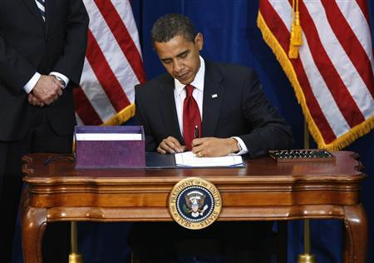
Historic Changes to the
National School Lunch Program
Healthy, Hunger-Free Kids Act 2010

Slide 7

On December 13th President Obama signed the Healthy, Hunger-Free Kids Act.
This historic legislation marked the beginning of the most comprehensive change to the school nutrition environment in more than a generation.
At least half of all grains offered must be whole grain-rich starting the 2012 school year.
All grains must be whole grain-rich starting the 2014 school year
For both breakfast and lunch, students must select
at least ½ cup fruit or vegetable for the meal to be
considered reimbursable
Increase quantities of fruits and vegetables from
¾ cup per day combined to 1 cup per day combined
plus an additional ½ cup fruit per day
Decrease sodium levels with a 10 year target to
reach the new levels (less than or equal to 640 mg)

Slide 8
Healthy, Hunger-Free Act of 2010
Implementation of the Paid Lunch Equity Provision which sets the standard for meal prices. The average price for paid lunches should be the difference between the per meal Federal reimbursement for free and paid lunches
Free reimbursement rate $2.77 minus
Paid lunch reimbursement rate $ .26
= $2.51
This year we increased lunch prices by 10 cent for both elementary and secondary lunches bringing the District into compliance with the PLE provision for the 2012-2013 school year. Each year the USDA will revisit this provision to ensure compliance.
Current Meal Prices for 2012-2013
Breakfast- $1.25
Elementary-$1.75- average in Florida- $2.00
Secondary- $2.10- average in Florida- $2.30

Slide 9


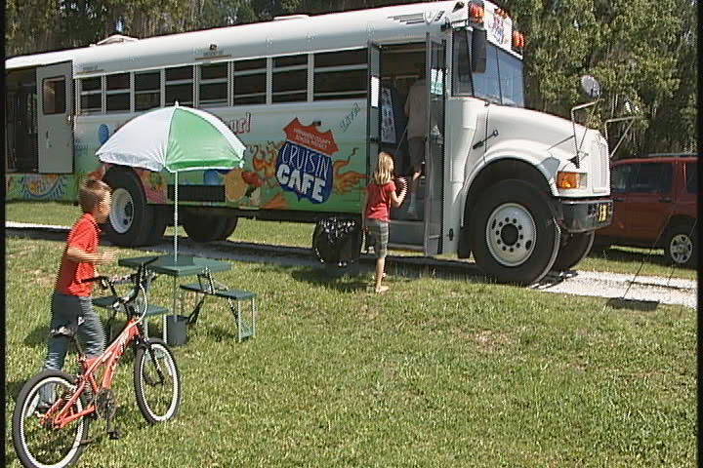
Summer Feeding Program
During the summer of 2012 we served 7 schools and the first ever Science Camp
-WEC, CEB, MBE, KHS, WES, SBJ and GCJ
Over 8,000 breakfast meals and over 14,000 lunches!
Summer 2013- Launch FNS first ever mobile summer feeding bus!!!

Slide 10
Fund Balance-2011-2012
In addition to 3 months of operating expenses we ended 2011-2012 with a
Fund Balance of $402,106.23
These additional funds will be put back into the school cafeterias as well as in our menus so they can best benefit the students of Clay County

Slide 11
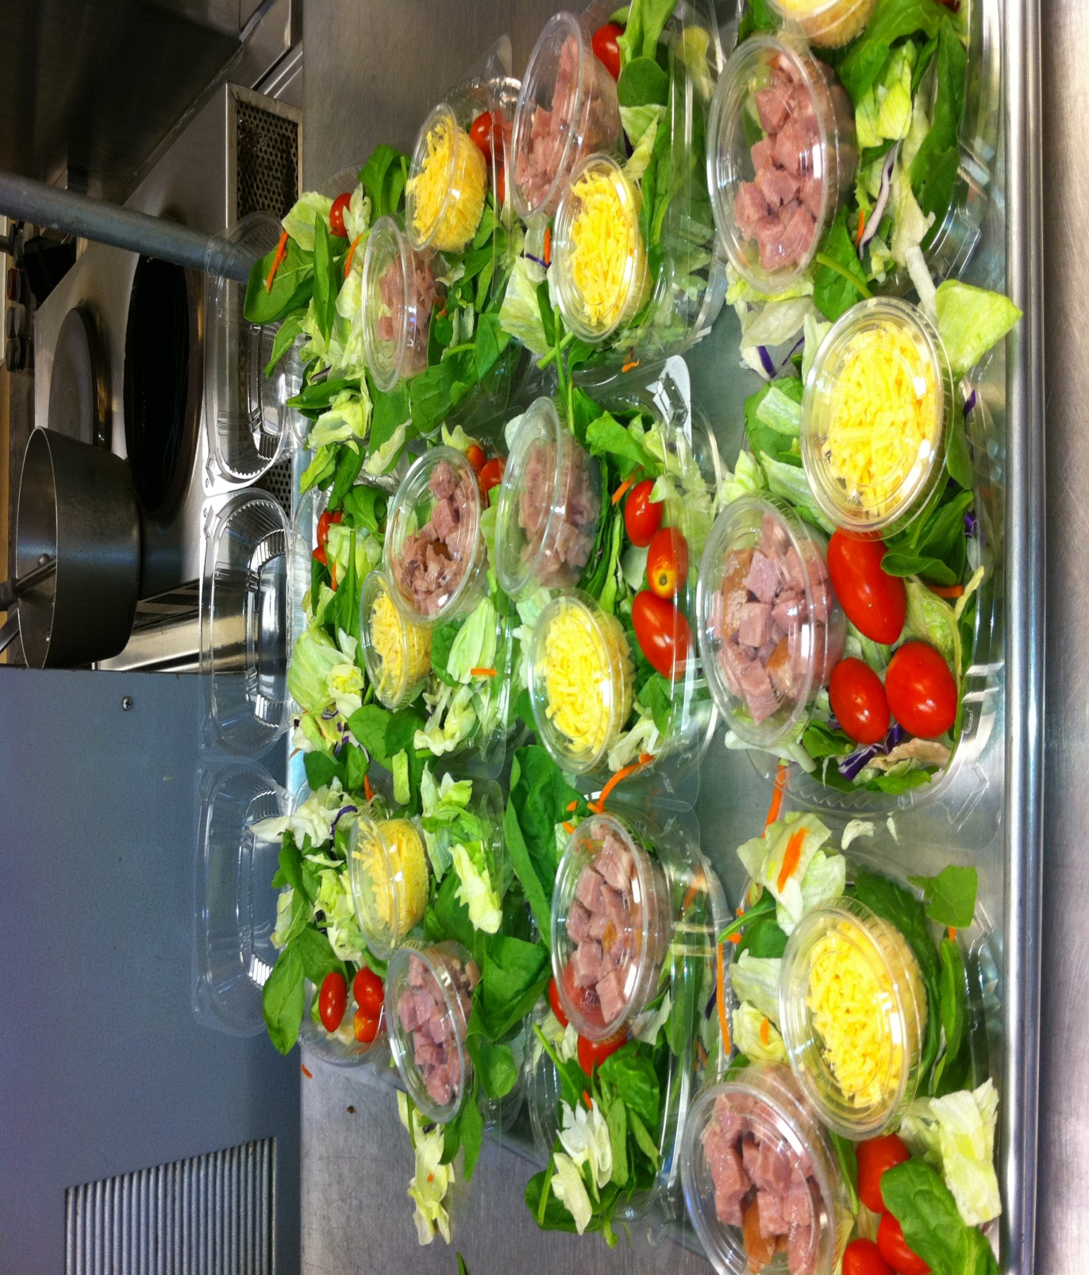
Putting Funds Back Into the Schools
More Variety of Fresh Fruits and Vegetables!

Slide 12
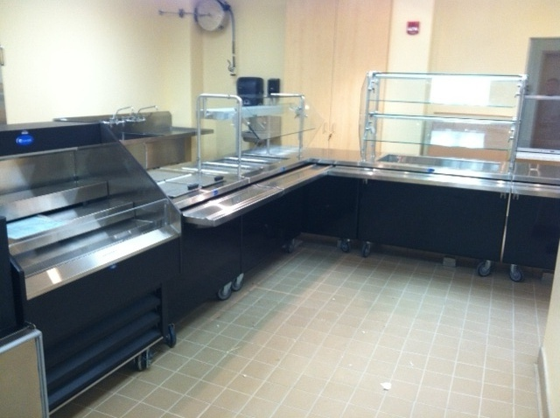
Putting Funds Back Into the Schools
Marketing!!!New Serving Lines and Signage

Slide 13
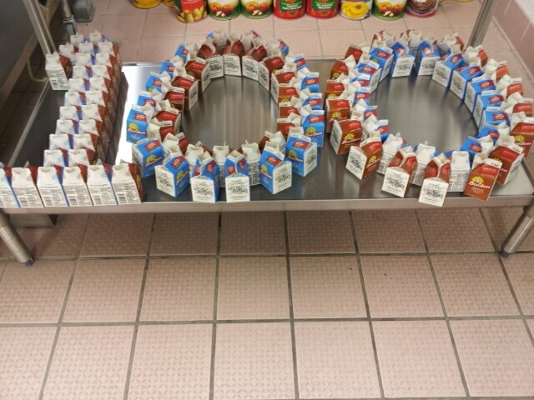
Going Beyond-Giving 100%
-First Ever Focus Groups
-Development of New Website
-Alternate Meal Policy
-Working Directly with the State to bring
Farm to School To Clay County

Slide 14
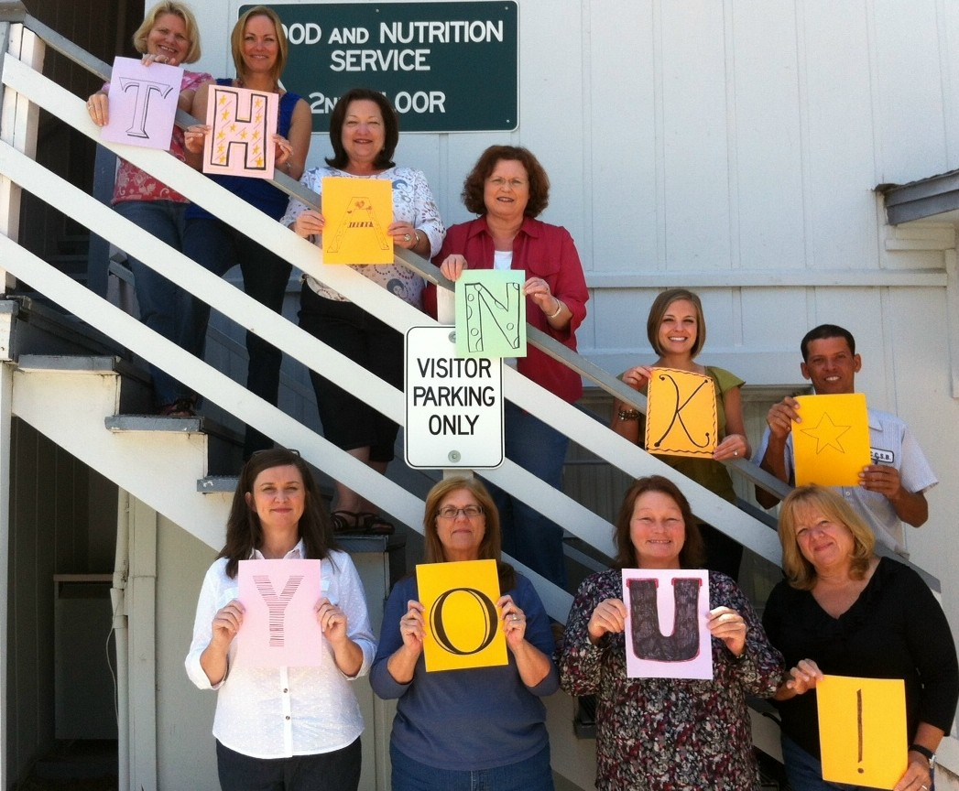
I often say the FNS Department is more than just hamburgers and hotdogs. We run a very complex program. Our department has put in place detailed policies and procedures to help ensure we not only run a cost effective program but a program that we can be proud of. In the over 2 million meals we have served so far this year I have not received one complaint about food quality or our menus.
The meals we serve to the students of Clay County are well planned and well executed by a team of professionals that care about the jobs they do. Food and Nutrition Services is not just a department, we are a team!

